Slide 1


Product Sales Analysis
Welcome to the Product Sales Analysis presentation. In this presentation, we will explore the key areas of data extraction, data visualization, and machine learning algorithms. We will also delve into the use of Jupyter Notebook for coding and data extraction. Let's dive in!

Slide 2

Contents
Data Extraction in Jupyter Notebook
Data Visualization Techniques
Data Models
Machine Learning Algorithms
Predictive Analysis For Future Sales Trends

Slide 3
Data Extraction Techniques
1
Web Scraping
Extract data from websites using Python libraries like BeautifulSoup and Selenium.
2
API Integration
Fetch data from various APIs such as social media APIs, weather APIs, and financial APIs.
3
Database Queries
Retrieve data from databases using Structured Query Language (SQL) queries.

Slide 4
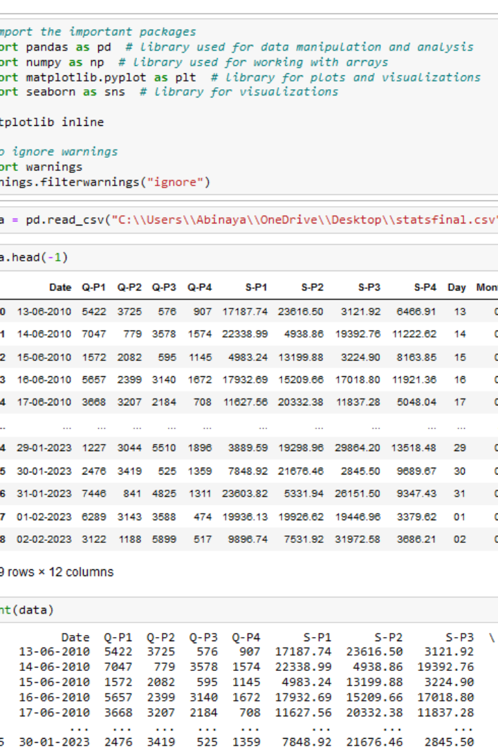
Data Extraction in Jupyter Notebook
Data Extraction is the process of extracting data from various sources such as CSV files, web, PDF, etc. Although in some files, data can be extracted easily as in CSV, while in files like unstructured PDFs we have to perform additional tasks to extract data from PDF Python.

Slide 5


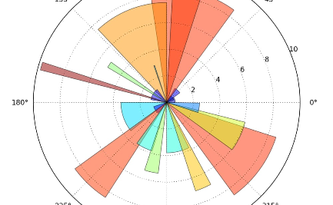
Data Visualization Techniques
NumPy
Pandas
Matplotlib
NumPy is python library used for working with arrays.
Pandas is a software library written for the python programming language for data manipulation and analysis.
Matplotlib is comprehensive library for creating static, animated, and interactive visualizations in python.

Slide 6
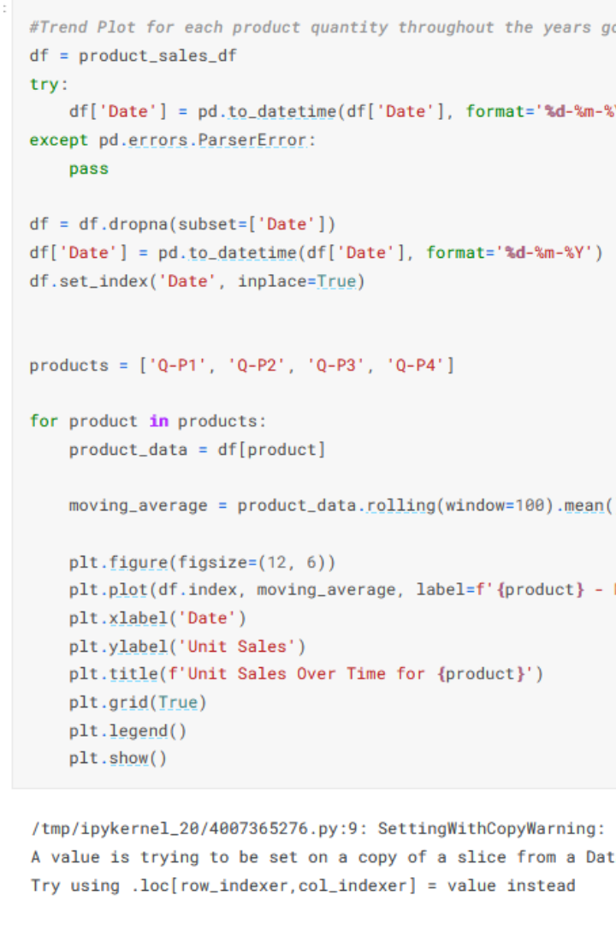
NumPy
NumPy stands for Numerical Python, and it is a fundamental package for scientific computing in Python. NumPy provides an efficient interface to store and manipulate large arrays and matrices of homogeneous data, such as numbers or characters. NumPy is built on top of the Python programming language and integrates well with other scientific computing libraries, such as SciPy, Matplotlib, Pandas, and Scikit-learn.

Slide 7
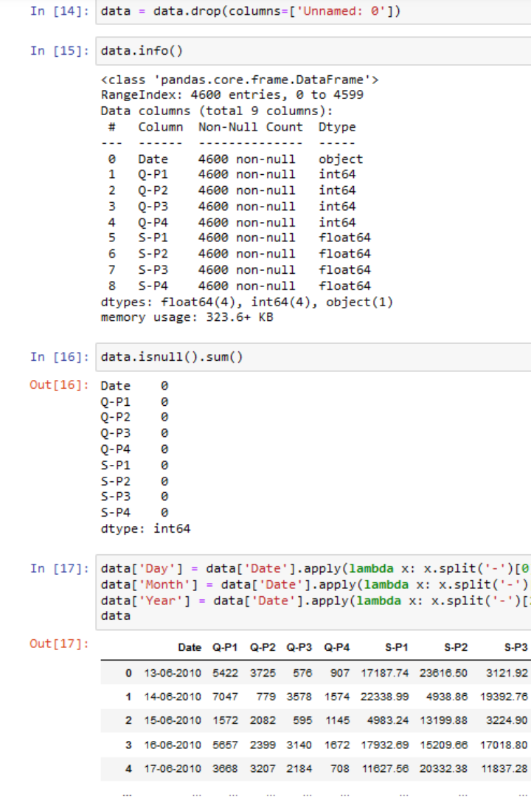
Pandas
Pandas DataFrame is two-dimensional size-mutable, potentially heterogeneous tabular data structure with labeled axes (rows and columns). A Data frame is a two-dimensional data structure, i.e., data is aligned in a tabular fashion in rows and columns. Pandas DataFrame consists of three principal components, the data, rows, and columns.

Slide 8
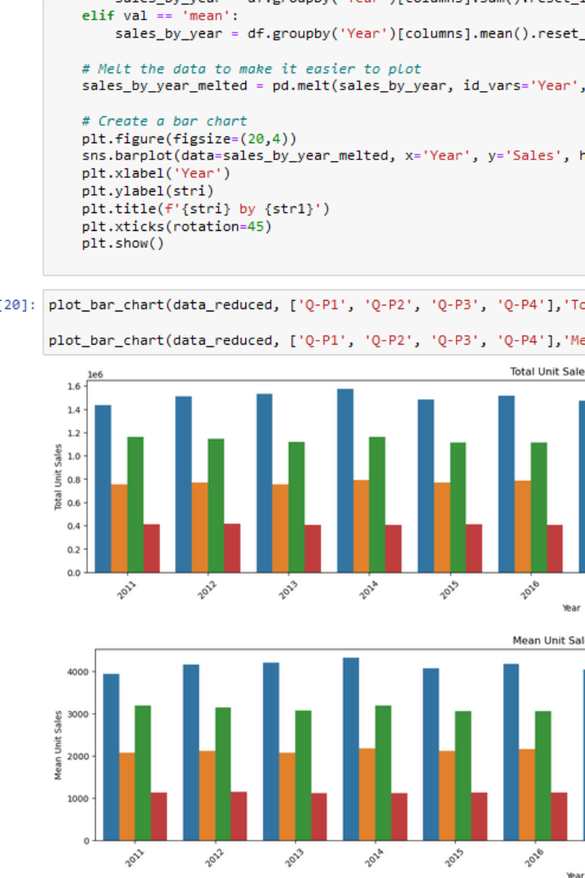
Matplotlib
Matplotlib is an amazing visualization library in Python for 2D plots of arrays. Matplotlib is a multi-platform data visualization library built on NumPy arrays and designed to work with the broader SciPy stack. It was introduced by John Hunter in the year 2002. One of the greatest benefits of visualization is that it allows us visual access to huge amounts of data in easily digestible visuals. Matplotlib consists of several plots like line, bar, scatter, histogram etc.

Slide 9
Jupyter Notebook: Code and Data Extraction
1
Introduction to Jupyter Notebook
Learn the basics of Jupyter Notebook, an interactive coding environment for data analysis and visualization.
Data Extraction in Jupyter Notebook
2
Explore various methods and libraries available in Jupyter Notebook to extract data efficiently.
3
Example Code: Numpy
Implement powerful numerical operations using the Numpy library for efficient data manipulation.

Slide 10
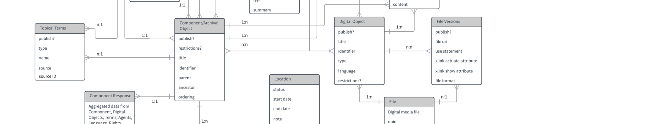
Data Model
A data model explicitly determines the structure of data. Data models are specified in a data modeling notation, which is often graphical in form.]
A data model can be sometimes referred to as a data structure, especially in the context of programming languages. Data models are often complemented by function models.

Slide 11
Machine Learning Algorithms
Random Forest
K-Nearest Neighbors (KNN)
Utilize ensemble learning to create a robust prediction model based on an ensemble of decision trees.
Classify data points based on their similarity to nearby data points, making predictions based on majority voting.
Convolutional Neural Networks (CNN)
Gradient Descent
Optimize model parameters using gradient descent, an iterative optimization algorithm widely used in machine learning.
Develop deep learning models for image classification and pattern recognition tasks using convolutional neural networks.

Slide 12
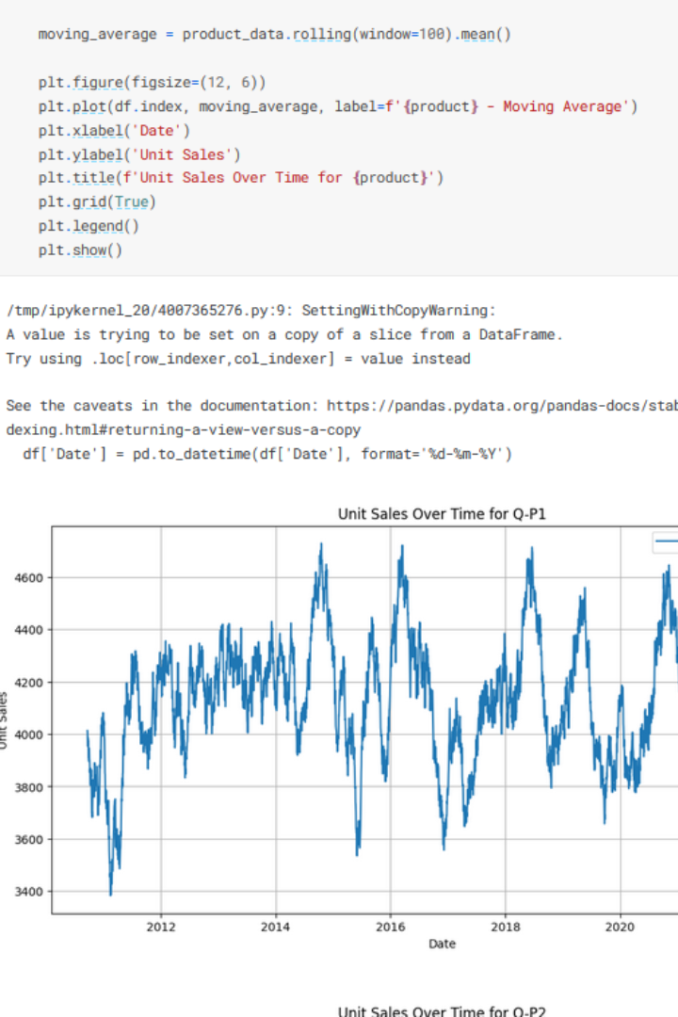
Random Forest Algorithm
A random forest is a machine learning algorithm used for both classification and regression tasks. It is an ensemble learning method, which means it combines the predictions of multiple individual models to make more accurate predictions than any single model. The individual models in a random forest are typically decision trees.

Slide 13
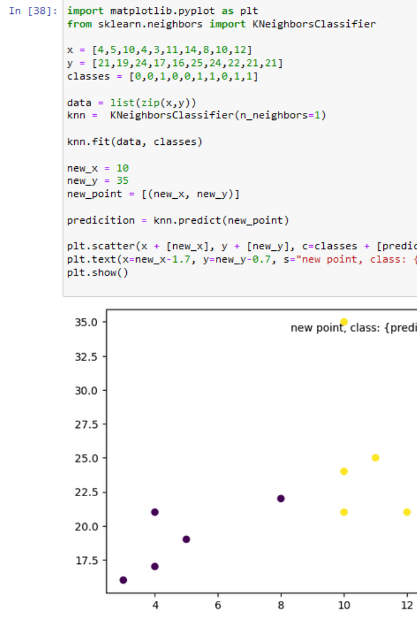
Convolutional Neural Networks (CNN)
Convolutional Neural Networks (CNNs or ConvNets) are a class of deep learning neural networks specifically designed for processing structured grid data, such as images and videos. They are a powerful tool in computer vision, image analysis, and pattern recognition tasks. CNNs are particularly effective in tasks that involve detecting patterns, objects, and features within visual data.

Slide 14
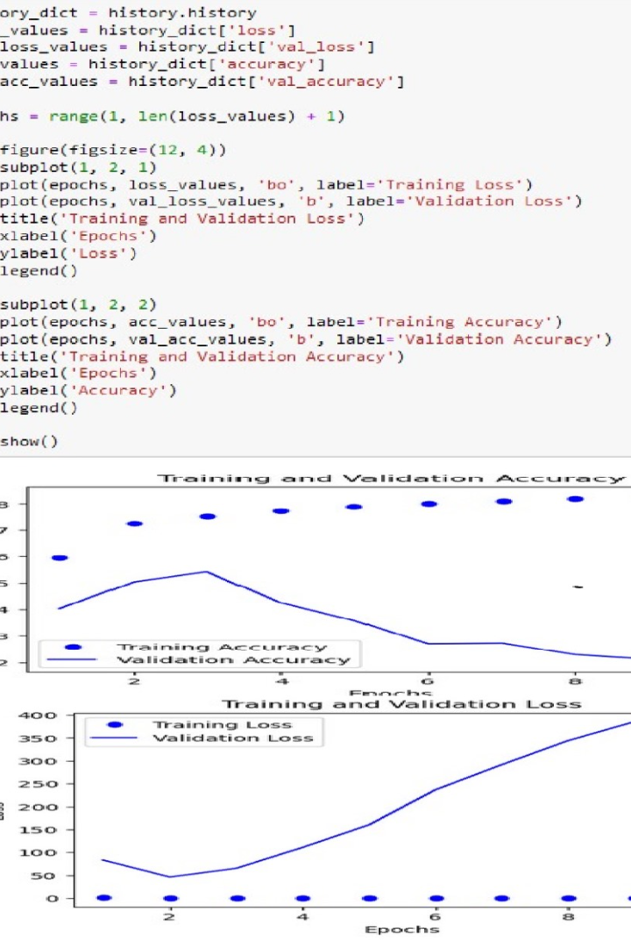
K-Nearest Neighbors (KNN)
K-Nearest Neighbors (KNN) is a simple and intuitive supervised machine learning algorithm used for both classification and regression tasks. It is a type of instance-based learning, where the algorithm doesn't learn an explicit model during training but instead memorizes the entire training dataset. KNN is based on the idea that objects (data points) with similar characteristics tend to be near each other in the feature space.

Slide 15
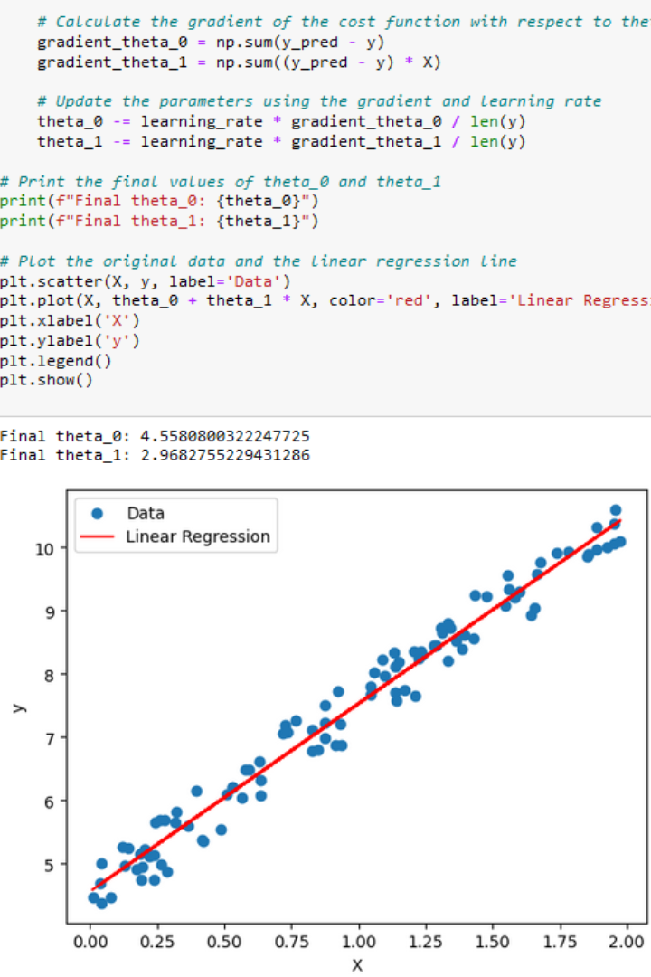
Gradient Descent Algorithm
Gradient Descent is an optimization algorithm used to minimize or maximize functions, typically in the context of machine learning and deep learning. It is widely employed in training models, including linear regression, logistic regression, neural networks, and other types of models where the goal is to find the optimal set of parameters that minimizes a cost or loss function.

Slide 16
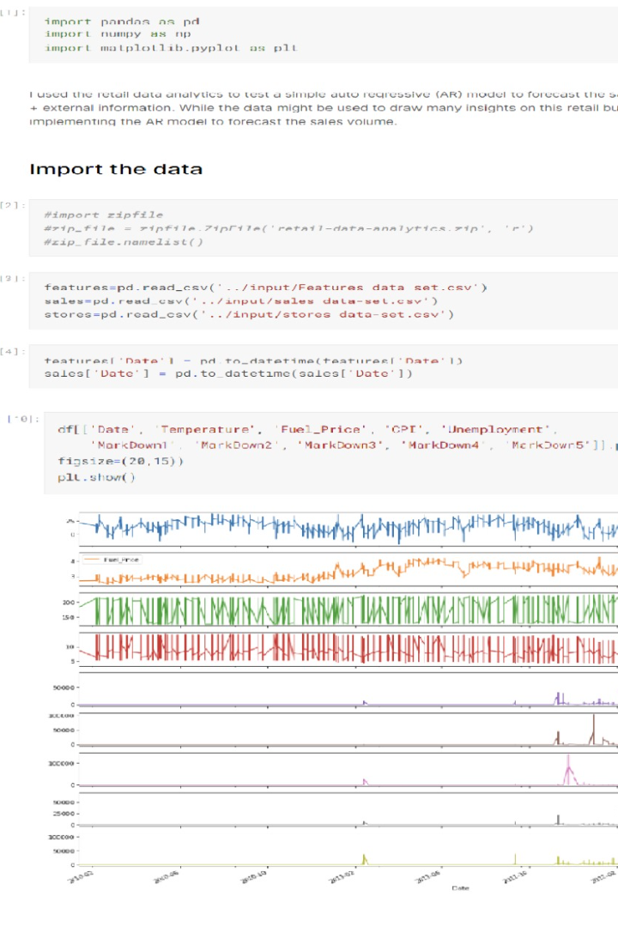
Predictive Analysis for Future Sales Trends
By applying advanced machine learning algorithms and analyzing past sales data, we can predict future sales trends. This allows businesses to make informed decisions and optimize their strategies for maximum growth and profitability.

Slide 17




Demand Forecasting
Price Optimization
Customer Segmentation
Sales Channel Optimization
Predictive analysis helps businesses accurately forecast product demand. By examining historical sales data, seasonality, and external factors, organizations can optimize their inventory, ensuring they have the right products in stock when customers need them.
Predictive models can recommend optimal pricing strategies. By analyzing customer behavior and market conditions, businesses can adjust prices to maximize revenue or market share. This dynamic pricing approach helps companies stay competitive .
Predictive analysis can identify customer segments with specific buying behaviors. By tailoring marketing and product recommendations to these segments, businesses can improve customer engagement and increase sales, Personalized marketing strategies
Predictive analysis can assist in determining the most effective sales channels. By analyzing historical data, businesses can identify which sales channels, whether online, in-store, or through partnerships, yield the best results.

Slide 18
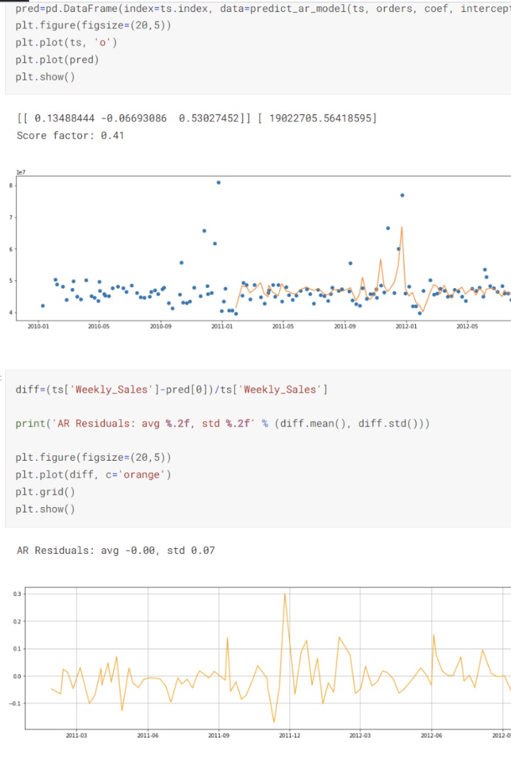
Predictive Analysis for Customer Behaviors
Understanding and predicting customer behaviors is crucial for targeted marketing and personalized customer experiences. By leveraging machine learning algorithms, we can analyze customer data to predict their preferences, buying patterns, and responses to marketing campaigns.

Slide 19
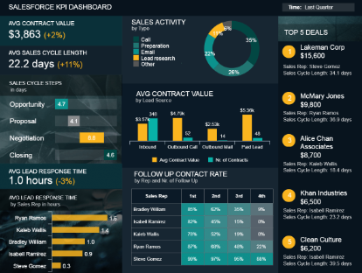

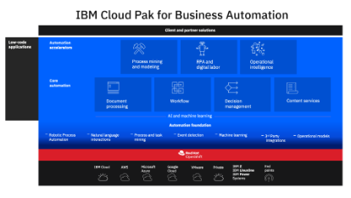
Cognos Analytics in Action
IBM Cloud Features
Interactive Dashboard
Data Analysis
Leverage the scalability and security of IBM Cloud to access your Cognos Analytics platform from anywhere, anytime.
Experience the power of Cognos Analytics with its interactive dashboard that allows you to visualize and explore your data like never before.
Uncover valuable insights and make data-driven decisions with Cognos Analytics' robust data analysis capabilities.

Slide 20

Conclusion
In conclusion, the Product Sales Analysis presentation covered key aspects such as data extraction, data visualization, and the use of machine learning algorithms. We explored techniques for extracting data from various sources, visualizing data using different chart types, and utilizing Jupyter Notebook for coding and data extraction. Additionally, we discussed machine learning algorithms like Random Forest, KNN, CNN, and Gradient Descent for predictive analysis. By leveraging these tools and techniques, businesses can gain valuable insights into future sales trends and customer behaviors, enabling them to make data-driven decisions and drive growth. Thank you for your attention!

